Slide 1
Session Objectives
By end of the session, you will be able to:
Define what is SOA
Recognize benefits of SOA layered approach
Define key components of SOA
Learn SOA principles
Understand the hyped “SOA is not web services” concept
Notes:
In this session, we will cover different concepts related to SOA, answering questions like
What is SOA and What are its benefits? how service oriented - layered approach to software development helps, and what are the key components of SOA?
we will also try to answer the popular question of, "Is Service Oriented Architecture same as Web Services"?
Lets get started with seeing why SOA is required in the first place.

Slide 2
Current IT World
Application
Screen
Scrape
Message
Download
Application
Application
Queue
File
Application
Screen
Scrape
Sockets
Transaction
Screen
Transaction
File
Scrape
File
Application
Download
CICS Gateway
Sockets
File
RPC
ORB
Application
APPC
ORB
Message
Application
Application
Message
Transaction
Queue
Application
File
Message
CICS Gateway
Queue
Transaction
Screen
File
Scrape
Message
Download
APPC
RPC
Application
File
Source: Gartner
Notes:
If you look at current IT world, we see a technology jungle, where almost every known technology is thrown together. These applications provide same or similar features, by re-implementing same functionality. These features are not reusable, since there is a lack of standard way of interacting, between different systems.
Business requirement in today’s world is that, we need to have a single customer view of entire applications, to increase productivity. We need to be able to reuse the capabilities or features, that we already have in the enterprise, so that the same feature is not re-implemented, multiple times. We need to reduce the time to market, for any new business requirement.
But without a standard way of designing and building software applications, there will be lot of redundancy, wasted effort, decreased ROI, to get any benefit out of existing systems. We see time and time again, where a business requirement which starts a project, to put an integrated feature together, will have changed by the time the solution is implemented, showing that the current IT architecture and standards, does not cut it, to deliver agile and flexible business solutions.
SOA is designed to provide answer for these kind of problems, and hence, we are seeing SOA being adopted and used, in almost all of the enterprises and products.
Examples of SOA being used is not just at enterprise level. SOA is dominantly used for integrating any systems worldwide, which aims to provide a reusable and composite feature. Some of the examples of services you see in real life are, search engines, Travel booking & reservation systems, Shopping cart applications, Cloud Services and more. In short, Services are everywhere!!!
So what is SOA? Is it a new concept? What does it all mean?

Slide 3
Let’s Organize a Party!!!!!!!!
Things to Do!!!!!!
Book Party Hall
Print party invitations
Send out invites
Arrange Food & Drinks
Organize Entertainment
Record the event
Arrange Transportation
Arrange Take Away Presents
Book Party Hall
Contact Publisher
Contact Courier Service
Contact Catering Service
Contact Tours and Travels
Contact Event Organizers
Shop for gifts
Notes:
Lets understand SOA, by looking at a simple real world example. We are looking to organize a party, and we have a list of things to do, like booking a party hall, printing invites, sending the invites out, arranging for food, entertainment, transport. That’s a lot of things to do if we are going to do all these works ourselves.
So, how do we solve this problem? To accomplish this, we will need to contact the relevant service providers, like a catering service for food, a courier service for delivering invites, and to make use of their specialized services to get the job done. Among the many service providers available in the market, we will choose one based on our preference and requirements. For example we may use FedEx or DHL or Blue dart as a courier service. We may use Hertz or Avion as transport service. Since these services are already provided by a service provider, we just pick and choose which services we want to use, for getting our work done, instead of re-doing their work ourselves.
This at its most generic form is exactly what SOA is about. We will architect the systems in such a way that we develop services in a reusable, discoverable and composable way, such that based on requirements, any of the services already developed, could be combined together, to provide a comprehensive solution to the problem at hand.

Slide 4
What is Service Oriented Architecture?
SOA represents an open, agile, extensible, federated, composable architecture comprised of autonomous, QoS-capable, vendor diverse, interoperable, discoverable, and potentially reusable services, implemented as Web services.
- Thomas Erl
What does it mean?
All application functions are modularized and presented as services
Build business oriented services instead of technology/project driven services
Service interface is independent of the implementation
Focus on reusable services rather than custom implementation of functionality
Service interfaces are based on public standards for interoperability.
Notes:
So, what is Service Oriented Architecture? Unfortunately, there is no one set of definition of SOA that everyone agrees on, and hence you will find different definitions depending on who you ask. One such definition, is provided by Thomas Erl, who defines SOA as an open, agile, extensible, federated, composable architecture comprised of autonomous, QOS-capable, vendor diverse, interoperable, discoverable, and potentially reusable services implemented as web services. That was a precise definition, but still too complicated for beginners to understand with lots of keywords.
Regardless of definition for SOA, almost everyone agrees, on the literal translation of SOA, as an architecture which is oriented towards services.
So, what does SOA mean?
SOA refers developing of application functions in a modular fashion, to be presented as services, for reuse. You would focus more on solving the business problems in services, rather than project related or technology related activities. Since these services need to be reused, across enterprises or systems, it has to be technology independent, with each service self describing itself, to provide details as to what it can do, without detailing implementations. Always try to see if a service is already available for reuse, before any effort is made to re-implement it. Always build services with interoperability and reuse in mind.

Slide 5
What is Service?
Services are unassociated, loosely coupled units of functionality that have no calls to each other embedded in them. Each service implements one action, such as filling out an online application for an account, or viewing an online bank statement, or placing an online booking or airline ticket order.
- Wikipedia
What does it mean?
In a traditional programming sense service is similar to a function.
A Service is a reusable component.
A Service changes business data from one state to another or implements some action.
A Service is the only way how data is accessed.
Service will be described in technology independent manner and will be easily discoverable.
Notes:
We keep hearing the term Service a lot when defining SOA. What exactly does service mean?
Service in a traditional programming sense is similar to a function. It is designed to provide a single action, like filing an online application, or viewing a bank statement, or booking an airplane ticket. It should be designed such that it is reusable, technology agnostic, and easily discoverable. Service should be the only way to access a business data and to provide a desired business feature.

Slide 6
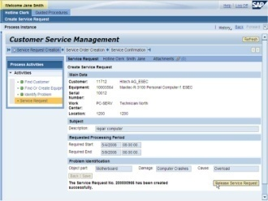
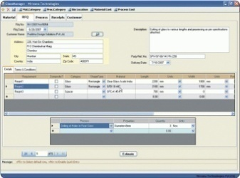
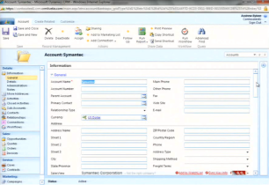
Traditional Applications – IT Silos
Multiple Customer Views
Customer Service
Check Customer Status
Check Inventory
Order Management
Check Customer Status
Check Order Status
CRM
Manage Customer
Check Inventory
Check Credit
Check Inventory
Check Credit
Check Order Details
Stand alone Traditional Applications
Data Repositories
Databases
Data Stores
File Stores
Custom
Apps
Cloud Storage
Notes:
Traditional Applications, IT Silos
In today’s IT world, we have large number of data sources, which hold the application data. This data is accessed by a number of independent applications, which implement same feature in multiple applications, without re-using existing functionality. This causes any changes to the data structure, requiring changes to all the consumer applications. Any changes to the business, requires update to multiple apps, and hence increased effort and time to market. These applications, have different set of user interfaces, causing a disjoint customer view, requiring user to log into multiple applications to complete the task.
Taking a closer look, Traditional Applications create IT Silos. As you can see from the example shown, even though check customer status service could have been re-used, between Customer service and order management applications, each application has its own version of code, accessing the data repository directly. This approach is not scalable, since there is no reuse of the service, client systems are not abstracted from data repository changes and there can be disjoint view of data between applications.
Lets see how we could solve this using the concept of services we saw while organizing a party.

Slide 7
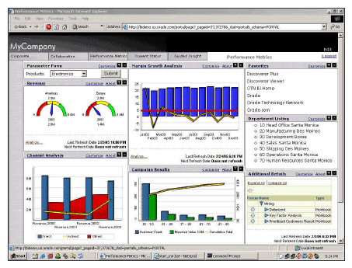
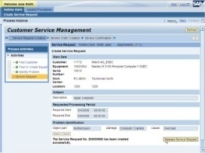
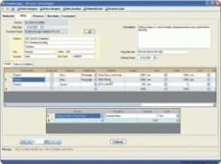
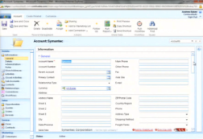

SOA – Layered Approach
Unified UI View
Composite Apps
Customer Service
Order Processing
Customer Account Mgmt
Other Composite Services
Composed Business Services
Check Customer Status
Get Inventory Details
Check Order Status
Create Invoice
Check Credit
Elemental Business Services
Data Repositories
Databases
Data Stores
File Stores
Custom
Apps
Cloud Storage
Notes:
SOA layered approach
SOA introduces a layered approach to enterprise problems. In SOA, we will have elemental business services at a separate layer on its own, which will be shared by all applications. These services implement data abstraction logic, utility service actions and business logic not dependent on any other services.
Using these elemental services, composed business processes will be built, which are by themselves exposed as services, for creating composite apps.
Note that the service doesn't just relate to back end information. These Apps and their graphical interface themselves, could be exposed as services, which can be used to create a unified UI view to provide consistent user experience.
As can be seen from this approach, since each of these services provide abstraction to underlying technology and lower level changes, it provides a very robust, flexible and scalable way to implement enterprise systems. Anyone interested in any service need not have to rewrite the logic, since they can just pick and use, existing services in the enterprise causing decreased effort, increased reusability and time to market. In an ideal enterprise, there will be only one set of services built and maintained, no matter how many applications access the data.

Slide 8
SOA Interaction Components
Service Description
Service Registry (Discovery Agencies)
2. Discover
1. Publish
Network
Service Consumer
Service Provider
3. Invoke
Service Description
Request Response
Client
Service
Notes:
SOA interaction components
Thinking back to our organizing party example again, how did we find a courier service for sending out invites? We would look up yellow pages or similar, to see what all courier services are available, and then based on our requirements, picked one, right?
Its exactly the same with SOA services. Service provider will publish the description of the service to a service registry. When service consumer is looking for a specific service, he will look up the service registry to discover the available services. Once the consumer receives the service provider information, consumer will directly invoke the service by contacting the service provider.

Slide 9
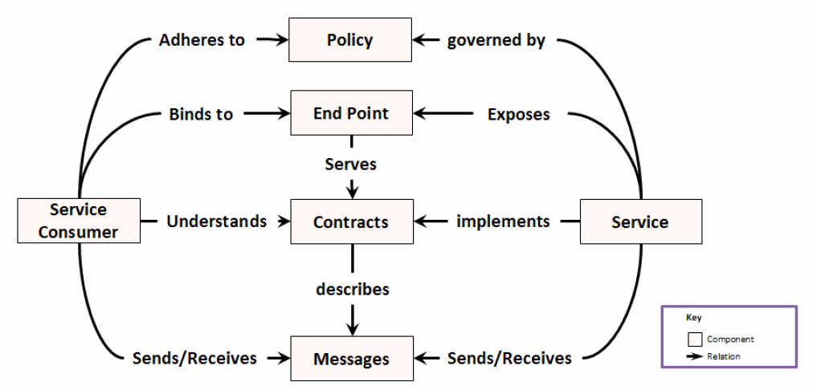
SOA Components – Service Level Interaction
Courier SLA
Courier Office
Client
Fedex
Courier Application
Invites
SOA Components (Arnon, 2006)
Notes:
SOA components, service level interaction
Lets take a look at components of SOA at play when a service is being provided or consumed.
Before diving into the SOA components view, lets re-analyze our organize party courier service in a bit more detail. For us to send out invites, we contacted the courier service local office, and they will ask us to fill out a form, which indicates what we are sending, where we are sending it to, and other information. We will choose the delivery timeline like, using a premier service for same day delivery, or normal delivery with some delay.
Contrasting this with SOA components in the slide, Service is courier service we are using.</p><p> we are the service consumers. Courier service local office is our end point, where we will send the packages.
Delivery form, which defines information about what we are sending, and how they accept the packages, and what service they provide, is equivalent to Contract.
Our invites or envelopes we provide, are equivalent to messages.
The type of delivery chosen, and its SLA like same day delivery or next day delivery - is an example of policy defined on courier service.
In real life, SOA dictates that a contract be defined for a service, which indicates the messages the service will receive as input, and provide as output. These services could be implemented using any technology, by binding the technology to the contract. Policies are declaratively attached to a service, to ensure the services live up to the standards agreed, like SLA, Security, etc.
These Policy, End Point, Contract, Messages are used by both the service provider and service consumer, such that they are bound by what has been agreed between them.

Slide 10
SOA Design Principles
Standardized Service Contracts
Loose Coupling
Abstraction
Reusability
Autonomy
Statelessness
Discoverability
Composability
Notes:
<p>SOA design principles</p>
<p>
Some of the main characteristics of SOA are that each service has a standardized service contract, defining what its doing, what it requires as input message, and what it provides as output message. Since the implementation of business logic is handled by the provider, and consumer is always working based only on the agreed contract between provider and consumer, consumer is abstracted by the implementation changes. These services are re-usable, since same service can be re-used, without re-implementing the logic, by consumer. Services should be discoverable so that anyone looking for a specific service, can just look up the list of services available easily. Services should be vendor independent, and hence they should be standards compliant.
</p><p>
Now at this point, you might be asking do I really need to know all this? Answer is no & yes. You don’t need to know all the low level details, as to how the service was designed. But knowing these principles helps you understand what you could test for, when you are designing test cases for testing services. Lets look at these principles at a high level, keeping discussion relevant for testers.
</p>

Slide 11
Standardized Service Contracts
Services are described using formal, standardized contracts expressing their capabilities in a technology agnostic manner based on public standards for interoperability.
Services use service contract which
Express their purpose
Express their capabilities
Data Representation or messages
Policies
Use formal, standardized service contracts
Service provider sticks to the agreed contracts for functionality and QOS
Service Provider
Express what Service can do, what QOS it can provide, etc using interoperable standards
Service Contract
Notes:
<p>Standardized Service Contract</p>
<p>
One of the main design principles with respect to services is that, the services needs to be described in a standard way, such that the users of the service, and providers of the service, will stick only to the contract, when requesting or providing feature. What this means is that if fedex is providing a shipping service, there should be a contract, which clearly defines what the service is trying to accomplish, what it would require as an input, like a cleanly packaged parcel, and what would be provided as an output like a courier acknowledgement receipt, or a tracking number, and policies applied on the service, like terms and conditions.
</p><p>
What this means for testers is that, the contract starts as the first main piece of artifact the testers would work with, since all your test cases will be based on the contract, and not on code. You would write test cases, with providing inputs and outputs defined in the contract, to see if the service is behaving according to the contract. On top of this, you would also check, that the contract is defined in a standard compliant way, and is interoperable with consumers from multiple technologies or protocols.
</p>
Example: Content negotiation → each service has it own artifact or blue print it will describe the purpose of its service
soap.-→ xml
Rest-→ can be any format it should be specific

Slide 12
Loose Coupling
Service contracts provide a boundary (both functional and technology) to provide independence (loose coupling) between service contract, service provider and service consumer.
Having standardized service contract ensures
Independent design and implementation of service provider
Service Consumer to access service functionality irrespective of service provider specifics
Service Contract to be technology agnostic and decoupled from business logic
Service Provider
Service Consumer
No dependency on service consumer
No dependency of service provider
Service
Contract
No dependency on business logic
Notes:
<p>Loose Coupling</p>
<p>
Since contract is the binding agreement between provider and consumer, there should be no dependency between consumers and providers.
</p><p>
What this means is that if the underlying service provider or service consumer changes, the entire integration need not have to be rechecked since consumer and providers depend only on the contract and not on each other!!
</p>
Example→ technology can be independent, method and design and what langauage

Slide 13
Abstraction
Service contracts will have bare minimum, absolutely required service information/metadata (on a need to know basis) only.
Hiding as much of underlying details of the service as possible helps in independence from underlying
Business logic
Business data and messages
Technology
QOS and policies
Service Provider
Express the bare minimum of details needed for consumers to utilize the service
Service Contract
Notes:
<p>Abstraction</p>
<p>
Abstraction refers to abstracting the implementation details, and technology details, of the provider from the service consumer, by developing a service contract which is technology, and business logic agnostic.
</p><p>
As for testing, you would make sure that there is no dependency documented in the service description, and that the description of the service is truly technology agnostic, and does not have any details regarding the business logic, which implements the service.
</p>
Example→ Techology is hidden and even design

Slide 14
Reusability
Services should express and implement agnostic logic (ie. without any customizations) and should be reusable as enterprise resources.
Services should
Implement generic functional logic
Be expressed using generic interfaces (ie. Canonical)
Be accessible concurrently
Be usable across multiple processes or contexts
Service should be reusable for multiple purposes
Notes:
<p>Reusability</p>
<p>
Services should be built keeping in mind that, the services could be reused in multiple business flows, for different business needs.
</p><p>
As a tester, you would test the contract, to make sure that the input and output are conforming to generic objects, or canonical objects, defined by the data architecture guidelines of the enterprise, and not developed locally by a project. For example, if there is a customer service which holds customer address details, and a shipping service using shipping address, there might be guidelines set up at enterprise level, which specifies that the address structure is defined at a common central location, and reused across all services. As a tester you might test the service, to see if the services are re-using the address defined centrally, or has the service defined its own custom address object.
</p>
Example→ Reuasability

Slide 15
Autonomy
Services should be as less dependent as possible on external resources and services.
Services should be isolated
Autonomy represents ability of a service to carry out its functionality without depending on external resources
Autonomy helps in
Increased reliability
Predicting behavior and QOS
Categorizing the usage of the service
Low
Autonomy
Dependent Autonomy
High Autonomy
High
Autonomy
Notes:
<p>Autonomy</p>
<p>
Autonomy refers to the design principle, which specifies that the service should be built independent of any other service or component, as much as possible. This helps in understanding, and tuning, of the services for a desired quality of service, and increases re-use and reliability of services.
</p><p>
As a tester, if the service doesn’t interact with other services or components, you would test the service based solely on the contract itself. If the service has low autonomy, you might want to test whether, all the dependent components or services are called with the right inputs, to deliver the desired feature.
</p>
Autonomy-→ self dependent.

Slide 16
Statelessness
Services should minimize resource consumption by implementing or utilizing stateful service/resources only when necessary.
Design services to defer state management as much as possible
Building stateless services helps in
Implementing agnostic logic
Reuse of services
Minimize resource consumption
Stateful
Stateless
Notes:
<p>Statelessness</p>
<p>
Statelessness refers to, building of services which doesn’t require service invocation context to be stored across multiple calls. Stateful services usually consume more system resources, and are less reusable compared to stateless services.
</p><p>
As testers, you would need to know whether a service is built as a stateful, or stateless service, such that you would be able to design test cases for checking the stateful flow, whether the test cases you have built can be reused or not.
</p>
Example: Groovy Script to store the response of the service

Slide 17
Discoverability
Services should communicate additional meta information promoting discovery and integration by consumers.
Services should communicate additional information like service taxonomy, technology and other information useful for both human (design time) and automated consumers (run time)
Communication meta information and taxonomy details are stored in
Service inventory or Service Repository
Service Registry
Service Inventory or Service Registry
1. Look up available service
New Service
2. If you can’t find one, build it
Services
Consumer
Notes:
<p>Discoverability</p>
<p>
Once the services are built, it should be published to a directory service or similar and should be discoverable by service consumers at both design time and run time.
</p><p>
As testers, you would make sure that the service is re-used by looking up the repository, to understand whether the service under test, is a re-implementation of an existing service in the enterprise. For run time checking, you would hook into a service registry, to check that the consumer code is working correctly with the registry and can successfully find run time service details.
</p>

Slide 18
Composability
Services should be designed for participating in different business flows to solve varying complex problems.
Services which solve smaller problems are composed to solve larger problems
Composability is closely related to reusability principle
Services should have flexible service contracts to allow different types of data exchange patterns for similar functions
Service execution for individual functions should be highly tuned
Service are combined to solve complex business requirements
Notes:
<p>Composability</p>
<p>
Composability refers to the ability of solving a complex business problem by dividing the problem into smaller problems and implementing the smaller problems as services. For example, organizing party complex problem was divided into smaller problems of couriering invites, booking party hall, organizing catering, etc and by re-using smaller services the end to end bigger problem was solved.
</p><p>
As testers, you would need to understand how the composed service is intended to behave and what services it might invoke, to make sure that you test the end to end flow by checking each of the component calls. You might even have to look into multiple systems or databases or files to make sure that the composed service is behaving as it should.
</p>

Slide 19
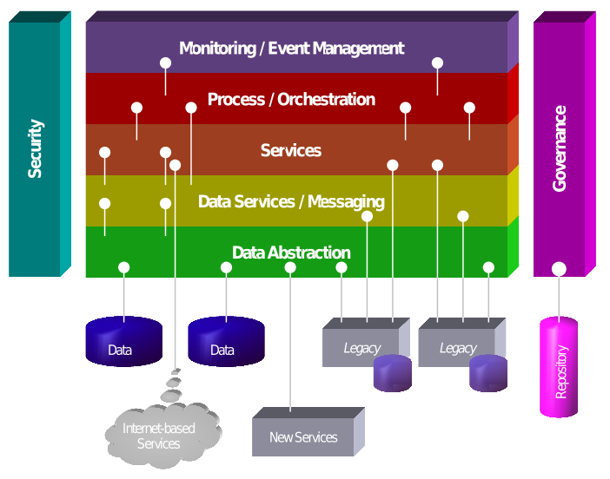
SOA Meta Model
Source: SOA meta-model, The Linthicum Group, 2007
Notes:
<p>SOA meta model</p>
<p>
SOA meta model provides a layered approach to classify different aspects of SOA life-cycle. Data abstraction, messaging and data services abstract low level data source changes from elemental business services in the services layer. Services layer generally consists of utility and shared business services between different composite processes. These utility and business services are grouped together to deliver business value similar to how we organized a party, in the process or orchestration layer. Run time monitoring of business processes would be key to getting a clear picture of what’s happening in the enterprise in real time, which are covered in monitoring or event management layer, by hooking into different service layers below. Note that these layers are depicted as horizontal layers, since each layer can utilize services in its bottom layers as per its requirements.
</p><p>
All these different types of services have security requirements, or policies applied on them since proper security to authenticate, authorize access, confidentiality and other security requirements needs to be applied for the service call, no matter which layer they belong to. There has to be coordinated effort to govern and manage life cycle of services irrespective of layers, which is provided by the governance layer. Since Security and Governance are common across the service layers, these are represented as vertical layers. Note that SOA Governance manages the SOA repository, where all the SOA artifacts will be stored and managed centrally.
</p>

Slide 20
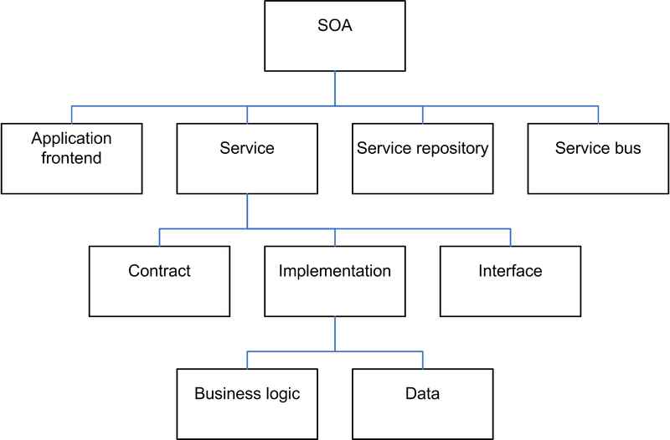
Elements of SOA
Source: Elements of SOA, by Dirk Krafzig, Karl Banke, and Dirk Slama
Notes:
<p>Elements of SOA</p>
<p>
As noted from the diagram above, SOA deals with more than just the implementation logic or service, but also deals with governance, design and management of the service lifecycle. Please note that the web service we keep hearing about, is at the service level dealing with everything at the service contract, implementation and interface level and hence forms only a subset of what SOA is about.
</p>

Slide 21
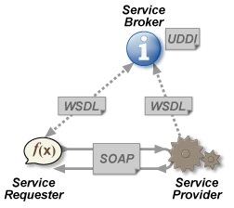
Web Services
Web Service is a software system designed to support interoperable machine-to-machine interaction over a network (web)
Standardized Contract
Described using WSDL – Web Service Description Language
Standardized Look up
Universal Description Discovery and Integration (UDDI)
Interoperability Standards
XML & SOAP – Simple Object Access Protocol
Technology Independent
Can be bound to any protocol like HTTP, JMS, EJB, Java, etc
Standardized Policies
Set of ws-* standards for handling all requirements of interactions like security, transaction, addressing etc
Web Service Framework Components
Notes:
<p>Web Services</p>
<p>
Web service is one way of implementing services defined in service oriented architecture. Web services support all the different design principles and characteristics we saw regarding SOA, with a standardized contract provided by web service description language or WSDL. Web services work with a directory service for discoverability by using Universal Description Discovery and Integration, or UDDI APIs. Web services use interoperability standards like XML and SOAP for exchange of messages between service consumer and providers.
</p><p>
Web services are technology agnostic such that you can plug in any technology to the web service stack and still keep the service defined in a technology agnostic fashion. It also provides support for defining policies on the service.
</p><p>
We will see web services and Web service description language in more details in later sessions.
</p>

Slide 22
SOA in Real Life
Services commonly implemented as
Web Services
REST Services
Service Component Architecture (SCA) Composites
Service Registry commonly use Universal Description Discovery and Integration (UDDI) as the standard for discovery of web services
Major standards/patterns for service use in enterprise
Enterprise Service Bus
Business Process Execution Language – BPEL
SOA is commonly used along with Event Driven Architecture
Notes:
<p>SOA in real life</p>
<p>
SOA is an architectural concept, from which services are majorly implemented in real life as web services, REST services, or Service Component Architecture. Note that since SOA requires using standards to work with services and can be any technology, any upcoming agreed upon standards could be used to implement services.
</p><p>
Web Services use WS-* and WSDL for defining the contract and policies to govern services. Service Registry component uses UDDI as the standard for discovery of web services.
</p><p>
Process or Orchestration layer mainly uses Business process execution language, or BPEL, language for implementation. Concept of Enterprise Service Bus is used for implementation of messaging or routing level service requirements.
</p><p>
Service Component Architecture is used to assemble different components in the enterprise.
</p><p>
REST services are built and re-used especially in a web 2.0, UI, mobile and light weight clients.
</p><p>
In an enterprise, there will be requirements to implement business processes and functions based on events as and when they occur. Hence, Event driven architecture is used along with SOA to deliver a truly flexible and adaptable solution in the enterprise.
</p>

Slide 23
Quiz
Which of the following is True?
SOA is just Web Services
SOA is just a marketing term
SOA supports vendor diversity
SOA is a set of principles and methodologies for designing and developing software in the form of interoperable services
Notes:
<p>
Its Quiz time!!! Lets see if you can answer some queries related to SOA refreshing what we have learnt. Please read the query on the slide and try to answer it.
</p>
<p>
The answer is 3 and 4.
</p><p>
SOA is not just web services, since SOA is more than just the implementation and covers the methodology for the entire life cycle of service development.
</p>

Slide 24
Quiz
Services should have the following characteristics
Standardized Service Contract
Reusability
Composability
Loosely Coupled
Autonomous
Notes:
<p>
Please read the query on the slide and try to answer it.
</p>
<p>
The answer for the query on the slide is 1, 2, 3, 4 and 5, since all of these are parts of design principles for designing services.
</p>

